Slide 1

BLE-Based Smart Tag System
Team J

Slide 2
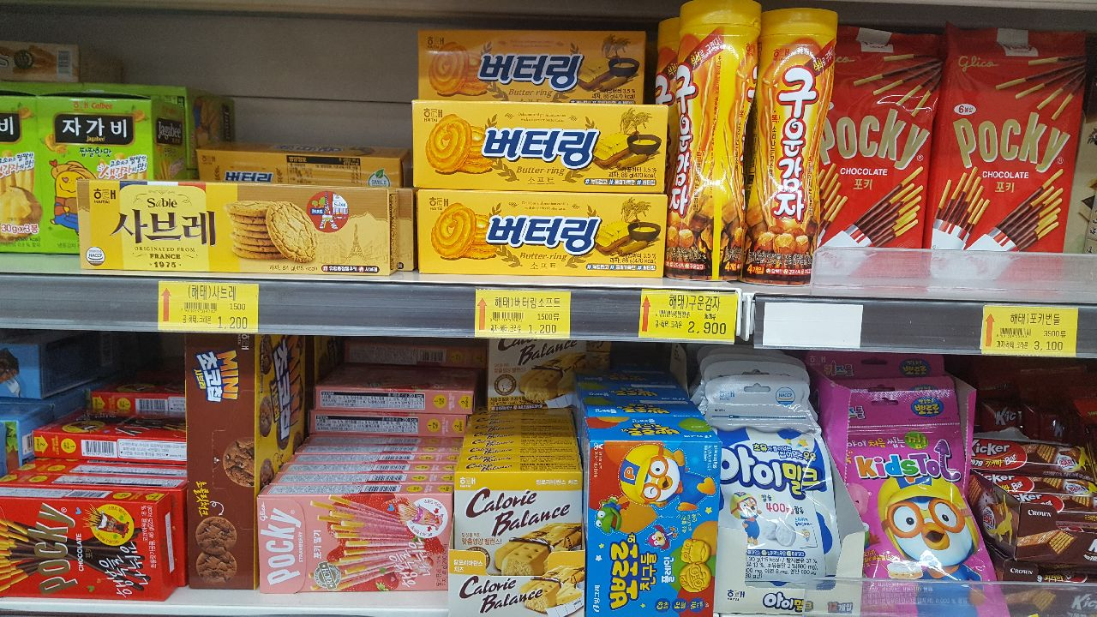

Slide 3
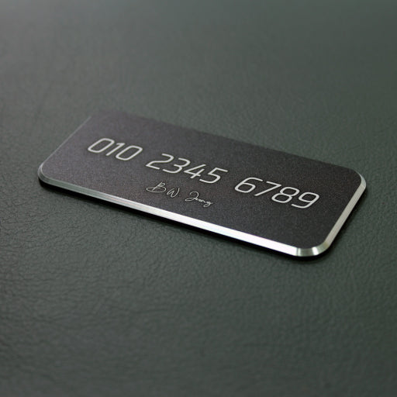

Slide 4
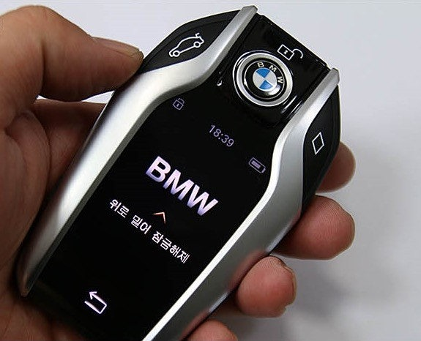

Slide 5
Enter and send a sentence from a smartphone BLE app
immediately displays it on the OLED tag
The ESP32 receives the sentence

Slide 6
ESP32
smartphone BLE app
BLE
OLED display

Slide 7
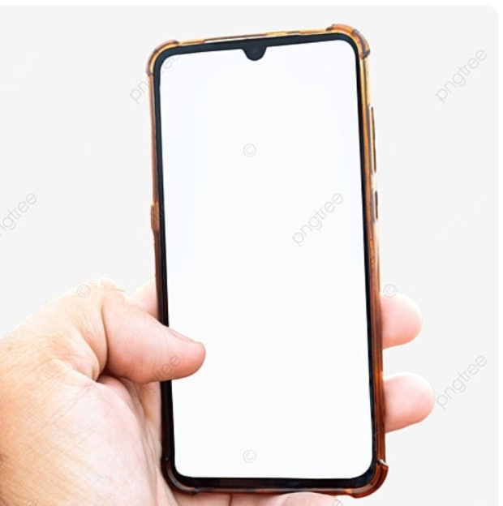

Slide 8
From one device to many — seamless updates, anywhere.

Slide 9
Differentiating factors
Provides a simpler and more intuitive user experience compared to traditional analog methods.
BLE enables continuous operation thanks to its low-power consumption.
Scalable to control dozens of devices simultaneously through integration with BLE Mesh or MQTT.

Slide 10
Contactless
Energy-efficient
Real-time

Slide 11

신인섭
김이삭
김문현
System Implementation
PPT & Script
Presentation

